Slide 1
Don’t forget Lecture quiz
First midterm in 1 week (look for email announcements)

Slide 2
Evolution (recap)
Descent with modification; genetic (allele frequency) change in populations of organisms over generations.
Natural selection was the mechanism emphasized by Darwin and Wallace
However, several other forces of evolution can cause changes in populations of living things

Slide 3
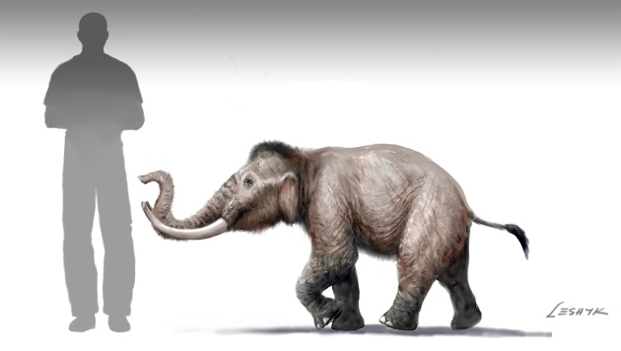
Forces of Evolution? (evolutionary agents)
Forces of Evolutionary Change in a population include:
-Natural Selection
-Sexual Selection (often considered a kind of nat. selec.)
-Genetic Drift
-Gene Flow
-Mutation
Fossil pygmy mammoths illustrate
rapid evolution on islands
Notes:
DWM – Darwin’s name for Evolution

Slide 4
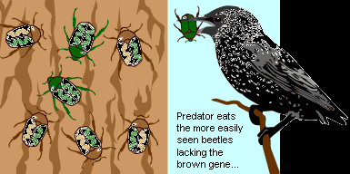
NATURAL SELECTION
Natural selection accumulates and maintains favorable genotypes (higher fitness) in a population- leading to adaptation
Modes of natural selection:
-Stabilizing selection
-Directional selection
-Disruptive selection

Slide 5
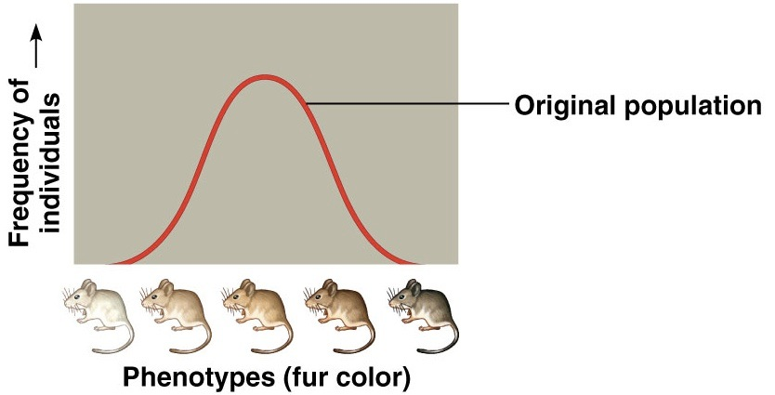

Slide 6
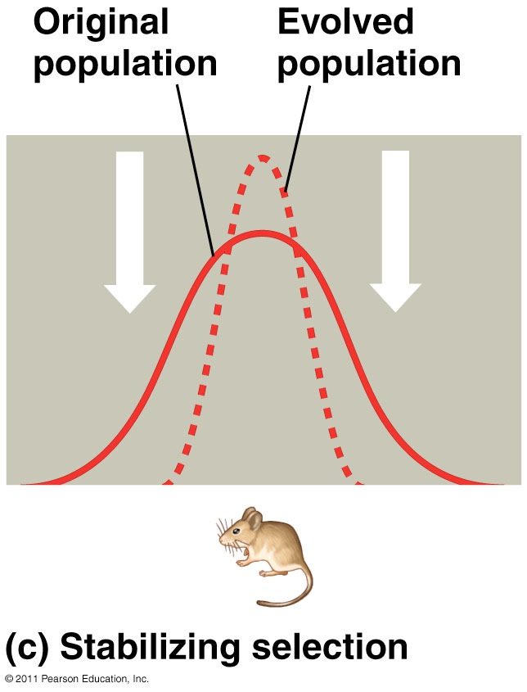

Slide 7
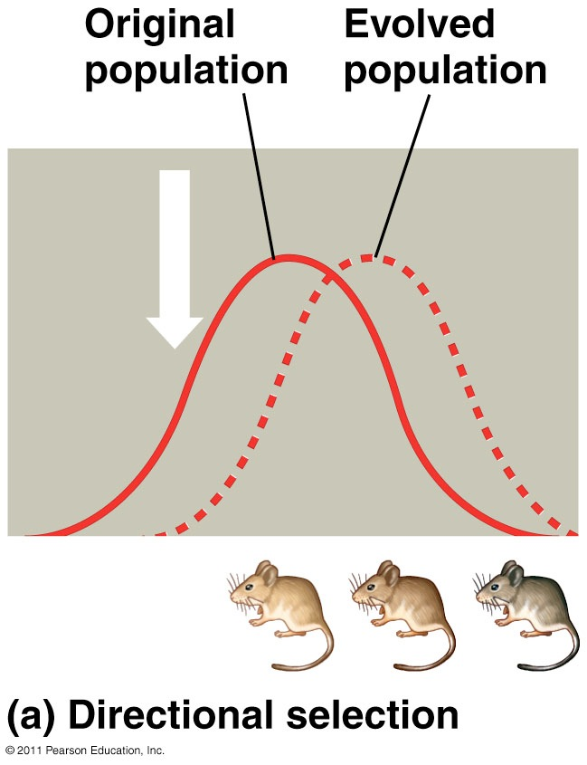

Slide 8
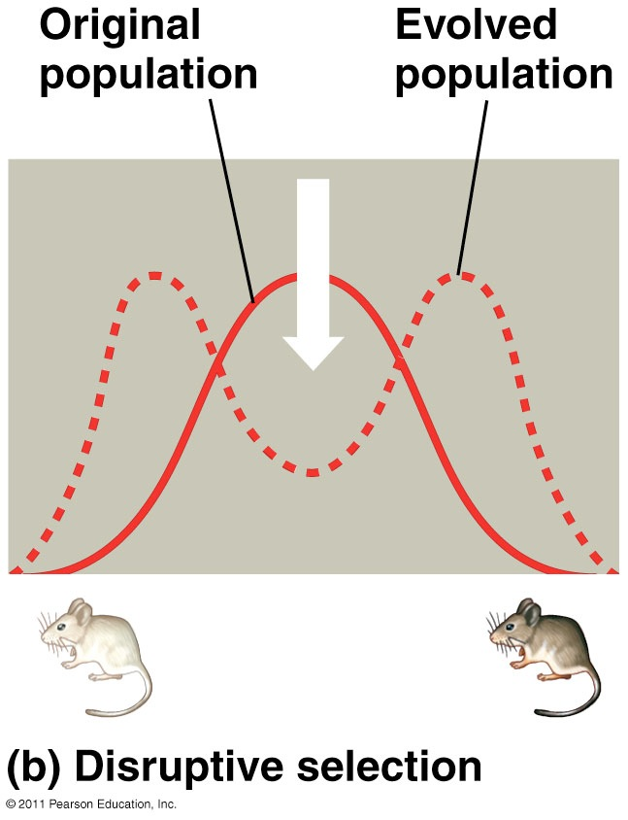

Slide 9
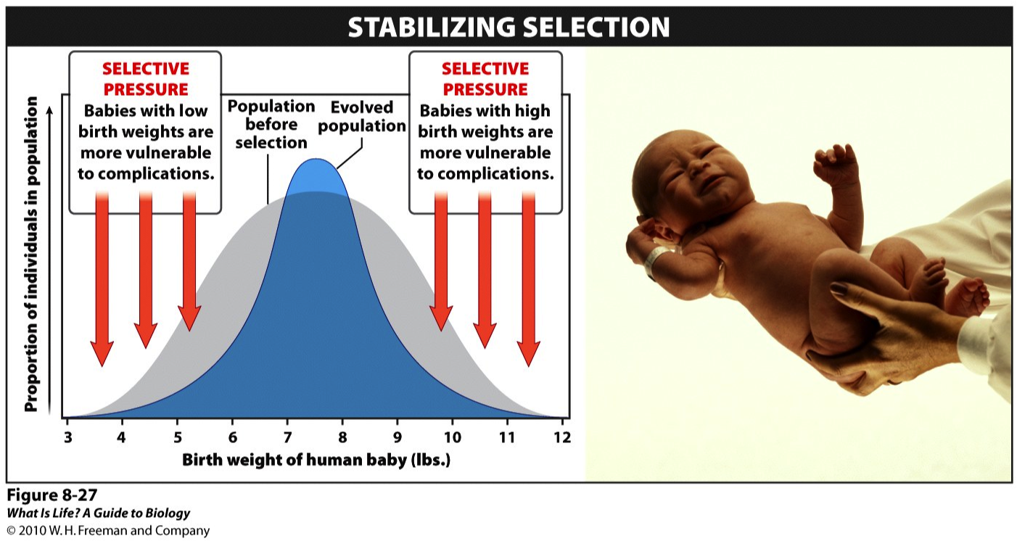
Example: Stabilizing Selection
Notes:
Maintaining a certain phenotype by selecting against deviations from it
Genetic diversity decreases
Most traits do not drastically change

Slide 10
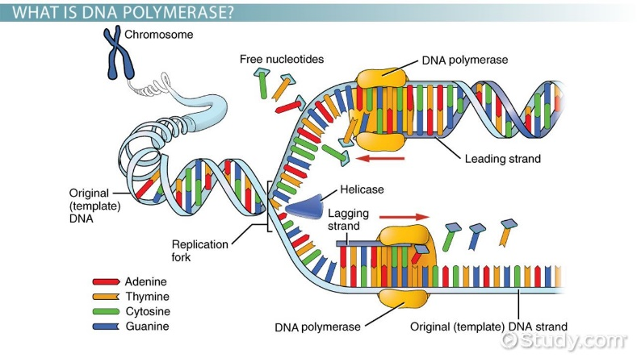
Mutation
Mutations produce new variation
Often caused by DNA polymerase* errors in DNA synthesis (or DNA repair)
(*the enzyme that helps duplicate DNA)
Mutations can be spontaneous errors or caused by mutagens

Slide 11
Kinds of mutations
(a partial list)
Large scale: large changes the number of chromosomes changes (e.g. chromosomes fused or cut in two)
Small scale:, e.g. substitutions or insertions or deletions of single nucleotide pair (point mutations); or of more than one nucleotide pair

Slide 12
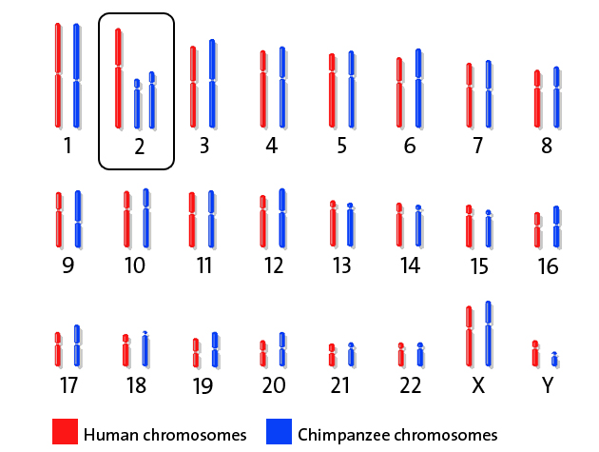
Large scale mutation
Large scale example: many apes (incl. chimpanzees) have 24 pairs of chromosomes, while humans have 23 pairs
Genetic studies show that two chromosomes fused during the evolution of the genus Homo to form our Chromosome 2

Slide 13
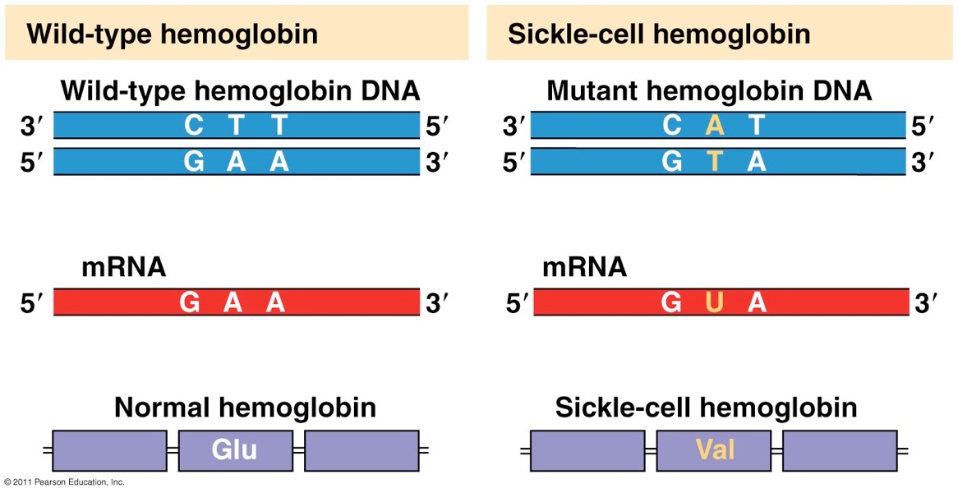
Small scale: Point mutations
missense

Slide 14
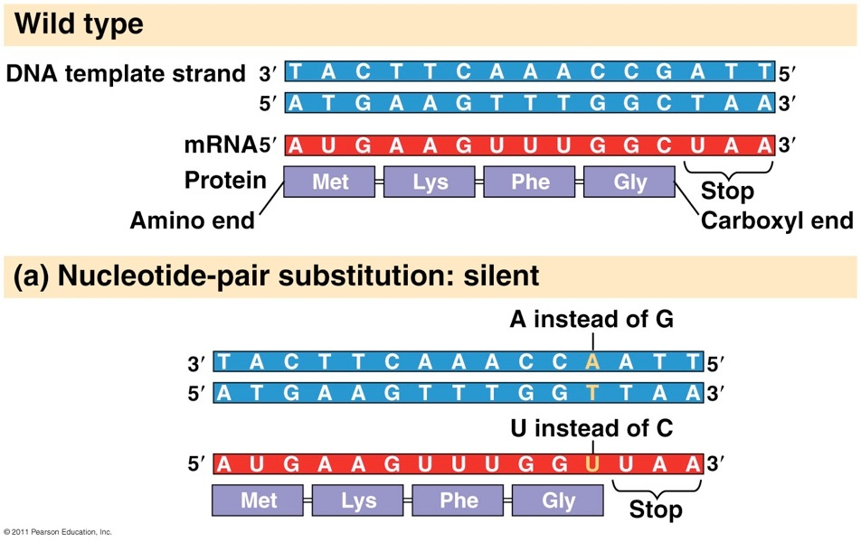

Point mutations

Slide 15
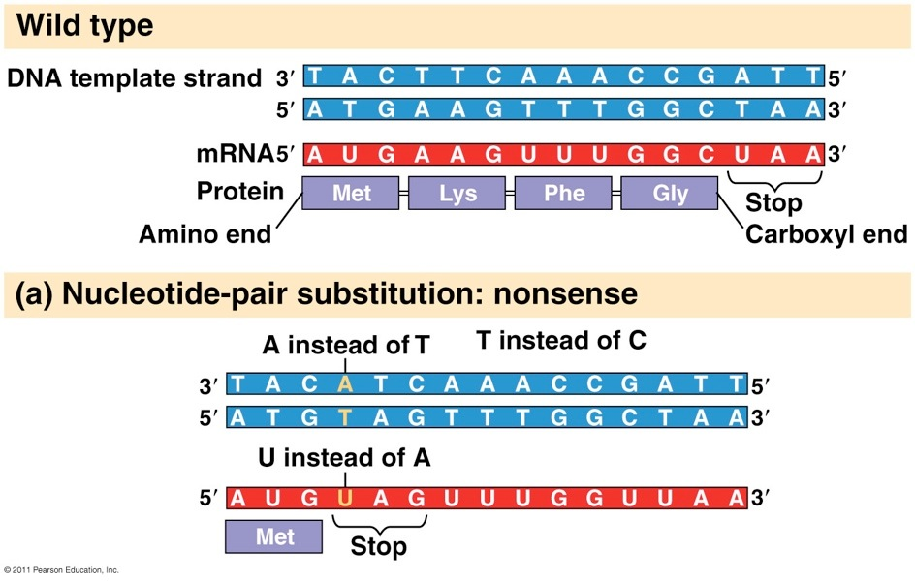

Point mutations
Point mutations (deletion, insertion) can also lead to frameshift (subsequent codon triplets shifted and all wrong)

Slide 16
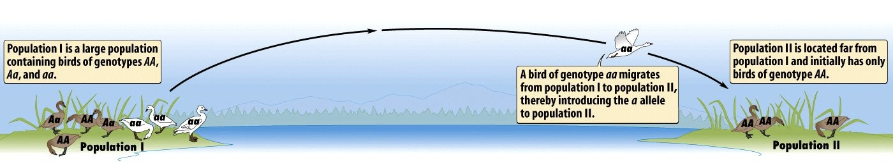
Gene flow
Consists of “flow” of alleles between populations due to movement of fertile individuals (or gametes, e.g. in pollen)
Causes populations to have more similar gene pools (can benefit pop. , but also sometimes be maladaptive)

Slide 17
Genetic Drift
Random changes in allele frequencies within populations which result from chance variation in individual survival and reproduction
Most important in small populations
Changes can be neutral, maladaptive, or adaptive
Examples:
-Bottleneck effect
-Founder effect

Slide 18
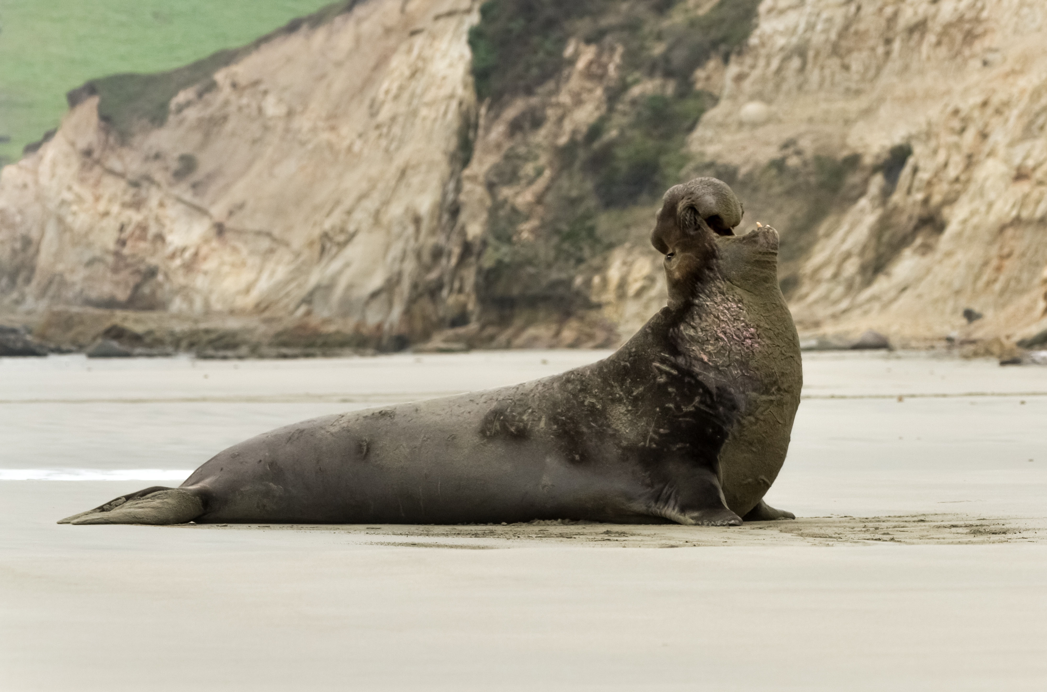
Genetic drift: Bottleneck effect (happens at near-extinction events)
Dramatic decrease of population size leaves only part of the genetic variation
Example: Northern elephant seals

Slide 19
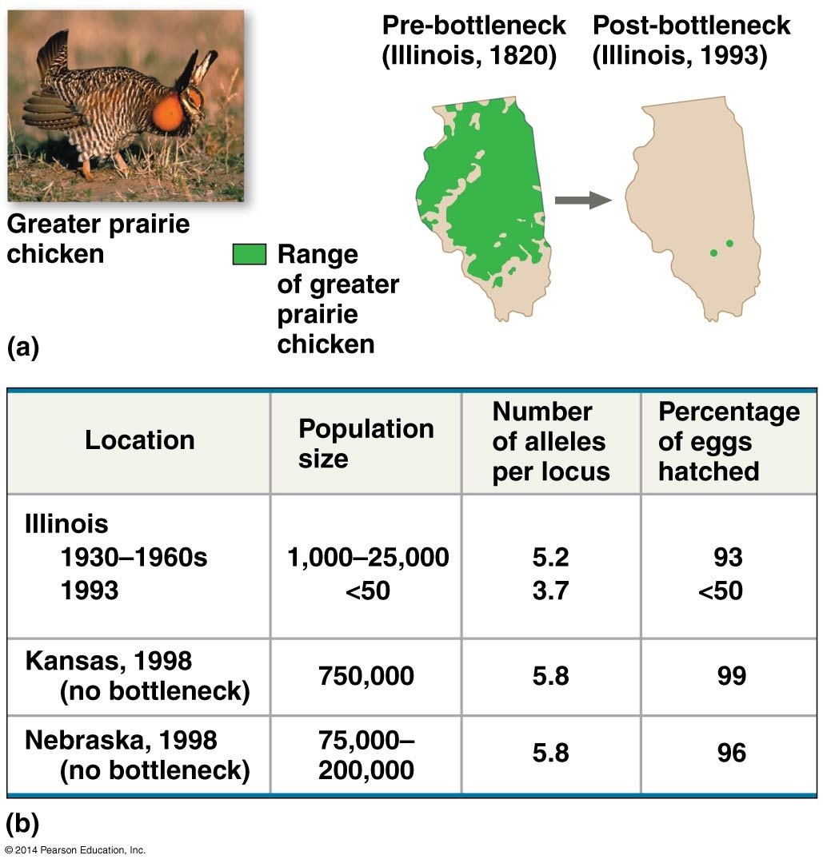

Slide 20
Genetic drift : Founder effect (happens at dispersion events)
Dispersion to small founder population can lead to random differences in allele frequencies
Mainland population gene pool
Island population
gene pool

Slide 21
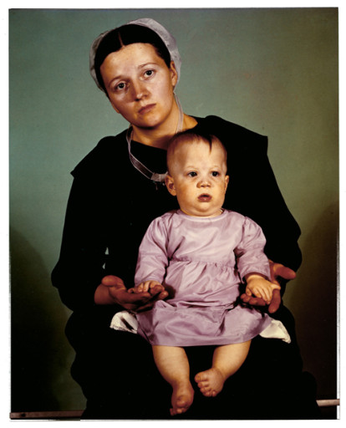
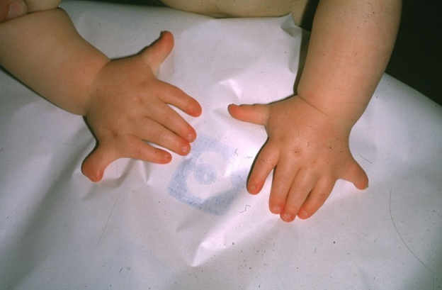
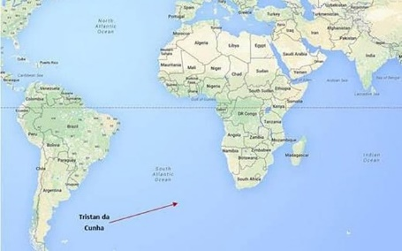
Genetic drift: Founder effect examples
Amish – small founder population – EVC syndrome (Ellis Van Creveld); polydactyl, short-limb dwarfism
Descendants of British colonizers of Tristan da Cunha – retinitis pigmentosa; blindness

Slide 22
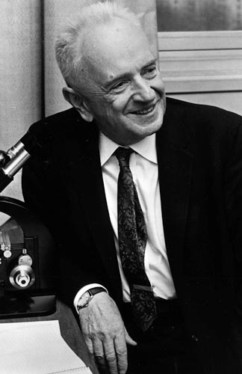
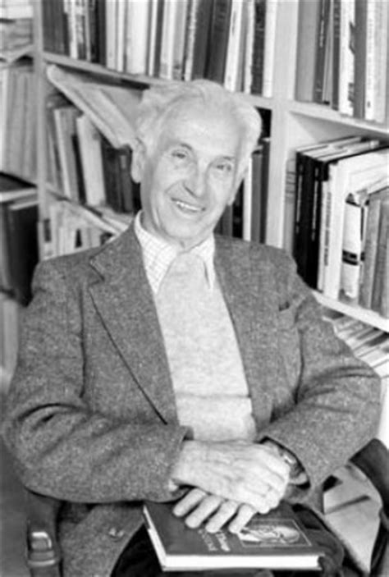
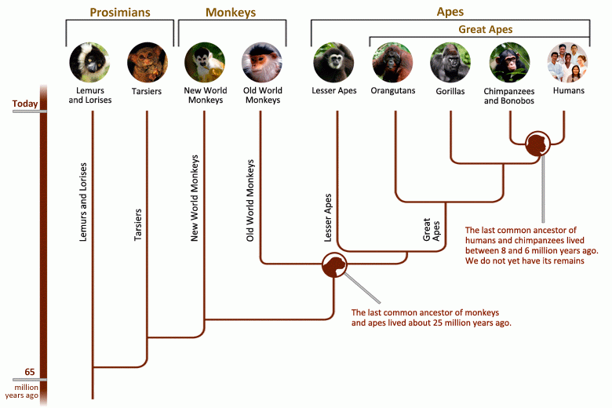
The Modern Synthesis
First half of the 20th century e.g. Ernst Mayr and Theodosius Dobzhansky
Natural selection combined with genetics, particularly Mendel’s inheritance laws (also DNA transcription, plus paleontology , speciation, and phylogenetics)
Dobzhansky 1900-1975
Mayr 1904-2005

